Slide 1


Data Requests Monitoring System
ETA Unit

Slide 2
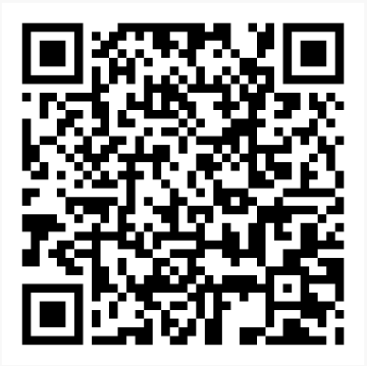
Data Requests Monitoring System
The Data Requests Monitoring (DRM) System is designed to manage and monitor data requests, and their deadlines within ECA.
DRM System Demo Version
Username: admin
Password: eca123
Double click to login on “Login” button
Do not use confidential information – this is an online version

Slide 3
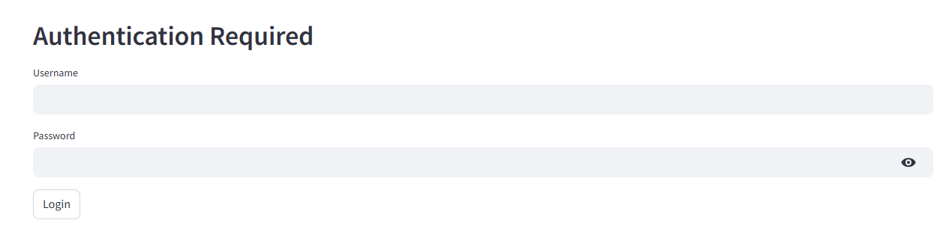
Secured logging in
The system requires authentication for login.

Slide 4
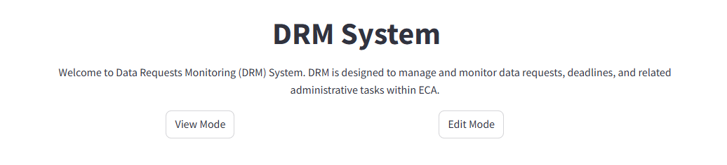
Logging in
The system is structured into two modes:
The system can be locally hosted by ECA.

Slide 5
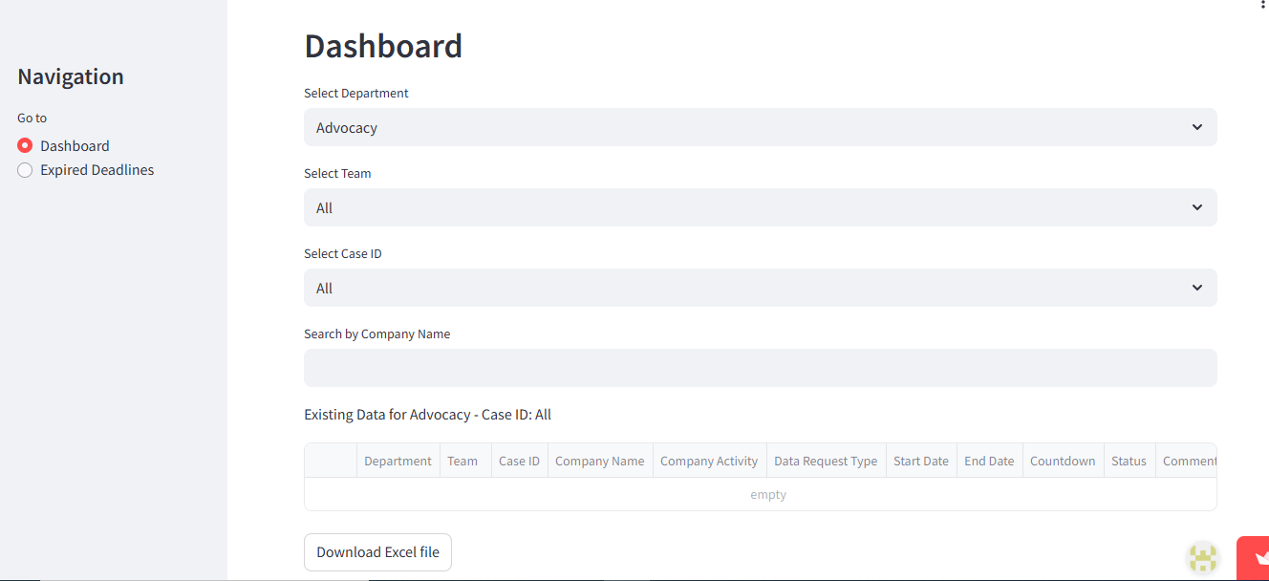
View Mode: Dashboard

Slide 6
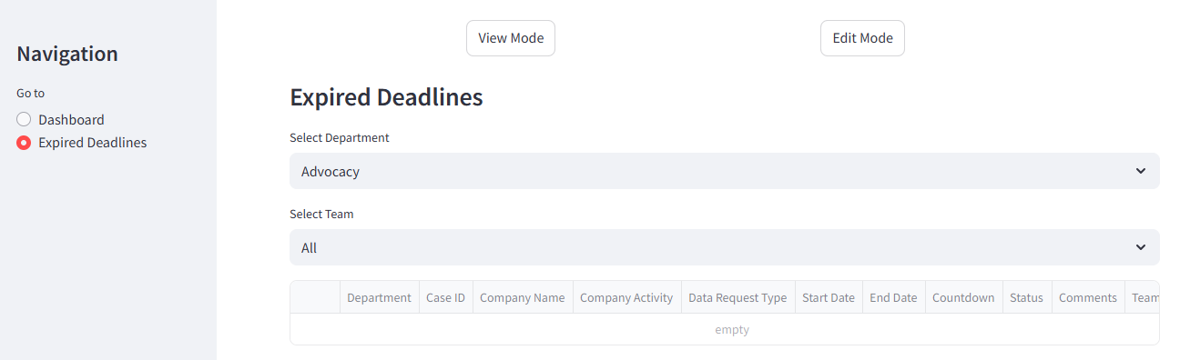
View Mode: Expired Deadlines

Slide 7
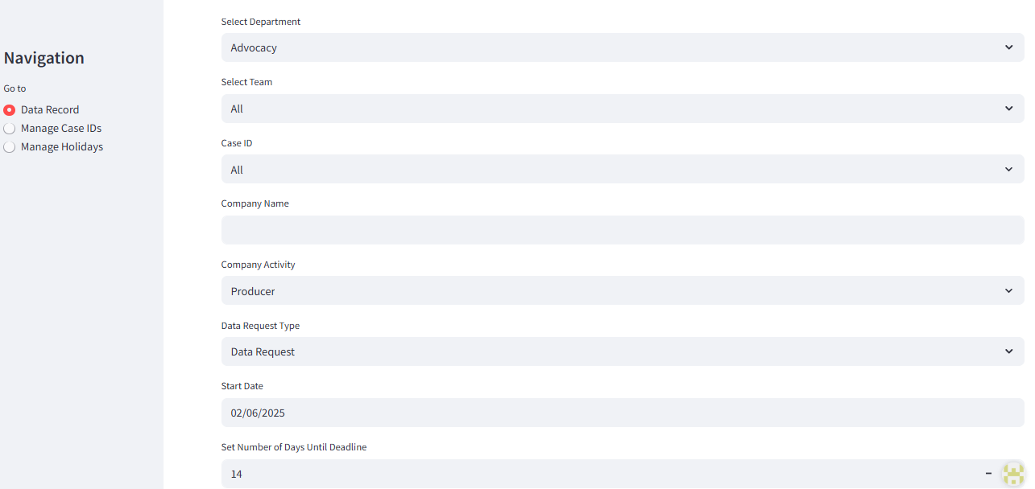
Edit Mode: Data Record
Activities include: Producer, Distributor, Other (specify)
Types include: Data request, 1st reminder, 2nd reminder, Data completion, Data extension
The count starts from the next day of the specified “Start Date”
The number of days set is in calendar days
Notes:
A field for “Sector” can be added

Slide 8
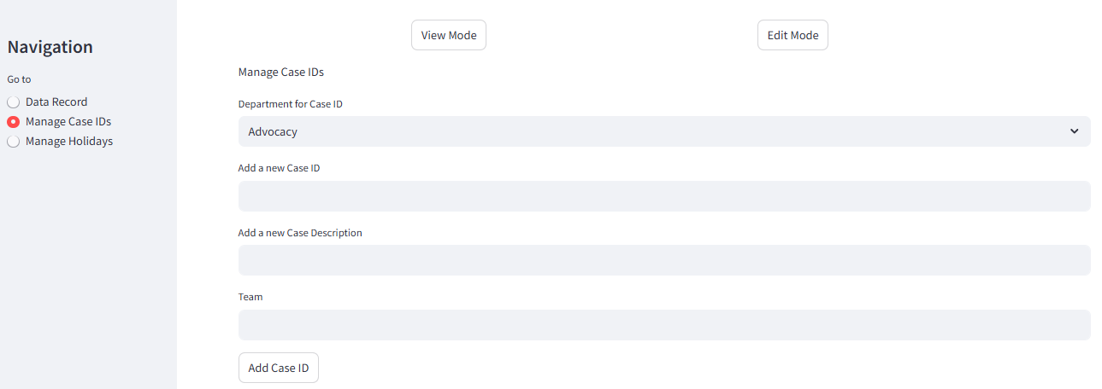
Edit Mode: Manage Case ID

Slide 9
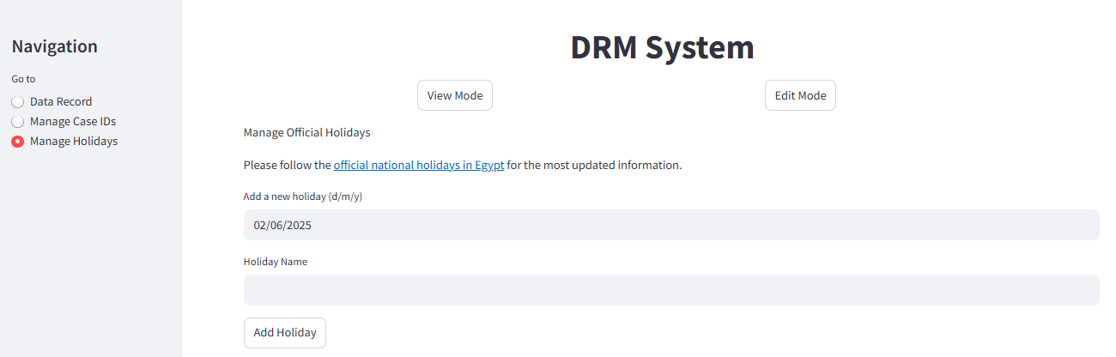
Edit Mode: Manage National Holidays

Slide 10
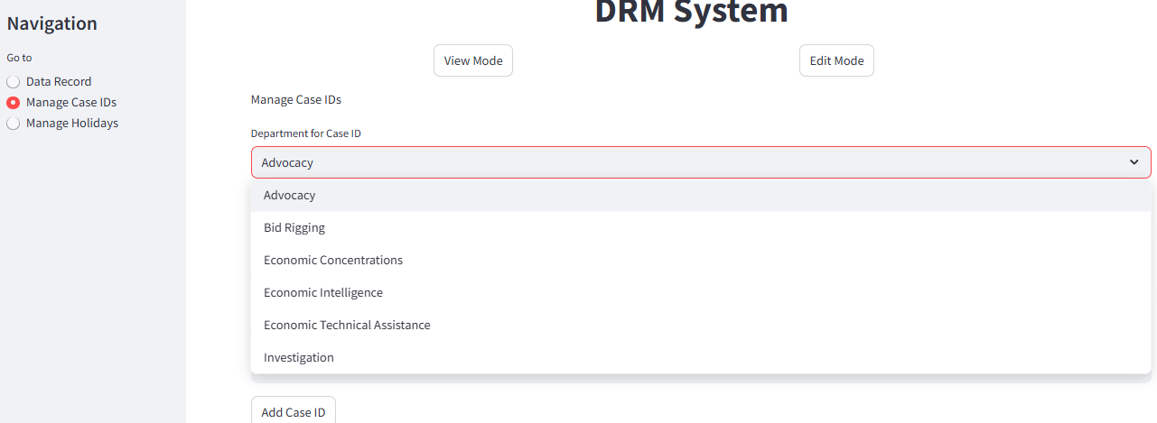
Example: Registering Case ID

Slide 11
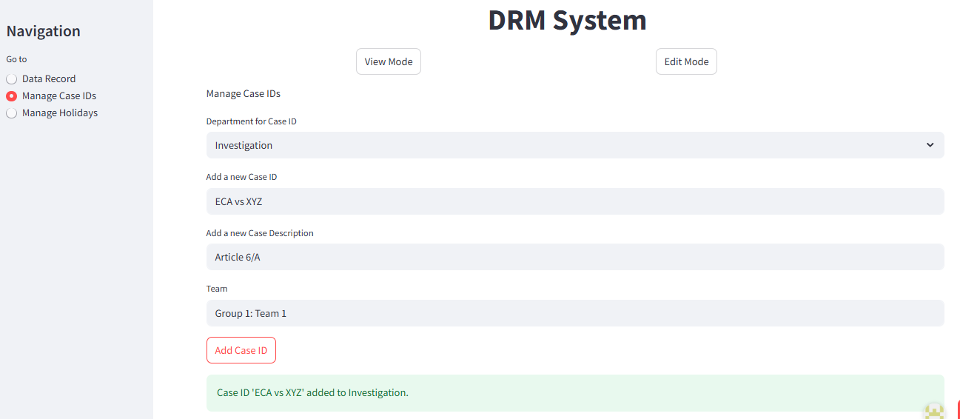
Example: Registering Case ID

Slide 12
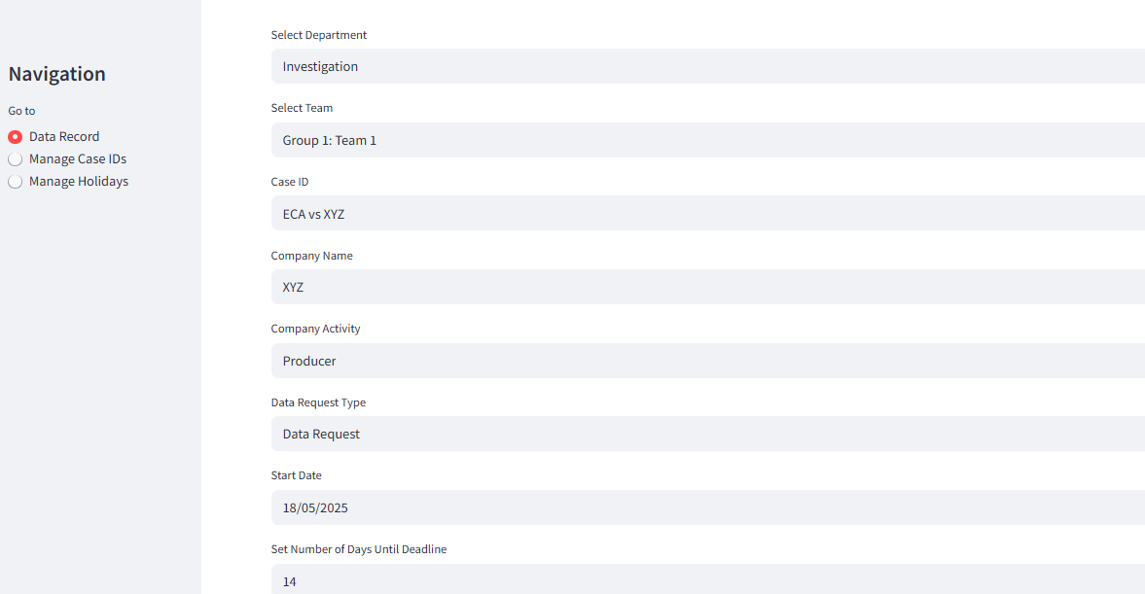
Example: Adding Case Details

Slide 13
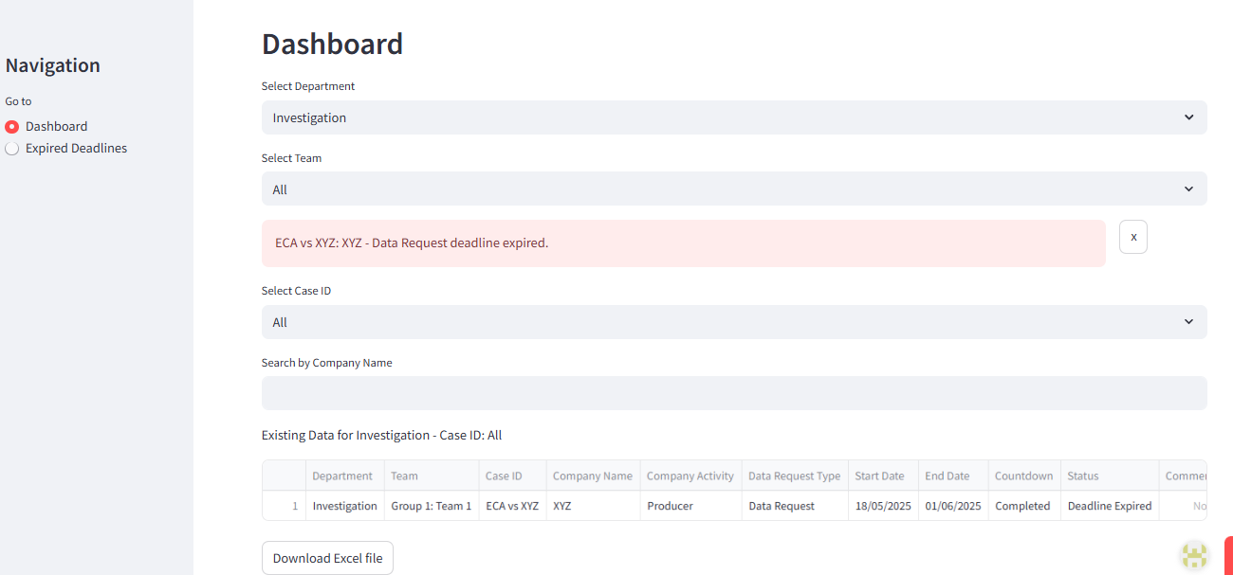
Example: Cases Dashboard
The system generates automatic warning notifications with expired deadlines and lasts for two days before disappearing
The deadline automatically adjusts in case of national holidays

Slide 14
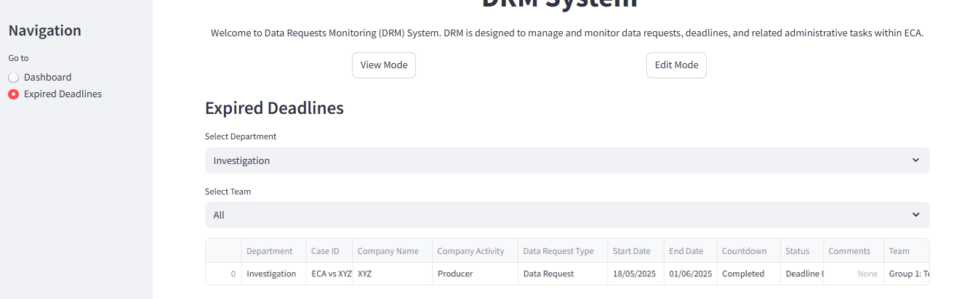
Example: Expired Deadlines

Slide 15
DRM System Demo Version
Username: admin
Password: eca123
Double click to login on “Login” button
Do not use confidential information – this is an online version

